Slide 1
Ordering System
Project By : Course : CSCI 567 (Intro. to Software Engineering)
Venkata Kavya Devarapally(Z1778592) Date : 3rd March,2016
Amulya Uppala (Z1787482) Instructor : Dr. Raimund K. Ege
Tejasvi Srigiriraju (Z1786900)
Koushik Gudla (Z1790371)

Slide 2
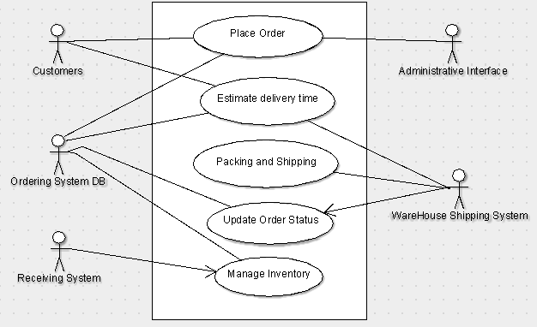
Use case diagram : Ordering System

Slide 3
Actor Dictionary

Slide 4
Actor | Description | UseCase(s)
Customer | Places an order by providing their name and mailing address. | Place Order Estimate delivery time
Ordering System DB | Contains Customer information, product details, status of the orders placed and estimated delivery per location. | Place Order Estimate delivery time Update Order Status Manage Inventory
Warehouse Shipping System | Responsible for Packing and Shipping products within the estimated delivery time, updating order status. | Estimate delivery time Packing and Shipping Update Order Status
Receiving System | Responsible for adding the products into the inventory list. | Manage Inventory
Administrative Interface | Responsible for including the shipping and handling charges, local tax rate while placing the order. | Place Order

Slide 5
Use Case Specifications

Slide 6
Name | Place Order
id | 1
Scope | Ordering System
Priority | High
Summary | Allows customer to select products from catalog and computes the total price of the order for payment.
Primary Actor | Customer
Supporting Actor(s) | Administrative Interface
Stakeholders | Credit card processing System
Generalization | NA
Include | NA
Extend | NA
Precondition | Customers will be presented with a custom ordering program
Trigger | NA
Normal Flow | Customer selects products from catalog. Customer should provide name and mailing address before placing the order. Administrative interface sets the shipping and handling charges, tax to the order. System computes the total price including the above charges. Customer enters credit card information and places the order.
Sub-Flows | 1.a. Customer inputs part number or description for selecting the product. b. System displays the search result. c. Customer selects the desired product. d. Customer enters the quantity. 5.a. Customer inputs credit card information which includes credit card number, Expiration date and purchase amount. b. Credit card processing system will authenticate the credit card details. c. Credit card processing system confirms with an authorization number.
Alternate Flow/Exceptions | Database is not accessible, Inappropriate part number or description
Post condition | NA
Open Issues | Authentication of customers Credit card
Source | Ordering System
Author | CSCI 567
Revision and Date | 0.1 03/02/2016

Slide 7
Name | Estimate delivery time
id | 2
Scope | Ordering System
Priority | Normal
Summary | Gets the location of the Customers from the Ordering System DB to predict the estimated delivery.
Primary Actor | Ordering system DB
Supporting Actor(s) | Customer
Stakeholders | Warehouse employees
Generalization | NA
Include | NA
Extend | NA
Precondition | Customer should successfully place an order.
Trigger | NA
Normal Flow | Customers location is fetched from ordering system DB. Provides the estimated delivery for the order to a particular location. Displays this information to the customer.
Sub-Flows | NA
Alternate Flow/Exceptions | Ordering system DB not accessible.
Post condition | NA
Open Issues | NA
Source | Ordering System
Author | CSCI 567
Revision and Date | 0.1 03/02/2016

Slide 8
Name | Packing and Shipping
id | 3
Scope | Ordering System
Priority | Normal
Summary | Responsible for retrieving the items, packing and shipping them for the order placed.
Primary Actor | Warehouse Shipping System
Supporting Actor(s) | NA
Stakeholders | Warehouse workers
Generalization | NA
Include | NA
Extend | NA
Precondition | Warehouse should receive the order details and the estimated delivery time.
Trigger | NA
Normal Flow | Warehouse workers retrieves the items from the warehouse. Products are packed. Invoice and shipping label is added to the product. After successful packing, the product is shipped.
Sub-Flows | NA
Alternate Flow/Exceptions | NA
Post condition | NA
Open Issues | NA
Source | Ordering System
Author | CSCI 567
Revision and Date | 0.1 03/02/2016

Slide 9
Name | Update Order Status
id | 4
Scope | Ordering System
Priority | Normal
Summary | Order status should be updated in the Database after successful packing and shipping.
Primary Actor | Warehouse Shipping System
Supporting Actor(s) | Ordering System DB
Stakeholders | DB Maintenance employees
Generalization | NA
Include | NA
Extend | NA
Precondition | Packing and shipping of the product should be done.
Trigger | NA
Normal Flow | 1. Completes the order by successful shipping . 2. Order status is reflected in the ordering system DB.
 | NA
Alternate Flow/Exceptions | Database is not accessible.
Post condition | NA
Open Issues | NA
Source | Ordering System
Author | CSCI 567
Revision and Date | 0.1 03/02/2016

Slide 10
Name | Manage Inventory
id | 5
Scope | Ordering System
Priority | Normal
Summary | After the products are delivered, the goods are added to the inventory and should be updated in the Database.
Primary Actor | Receiving System
Supporting Actor(s) | Ordering System DB
Stakeholders | Product Suppliers
Generalization | NA
Include | NA
Extend | NA
Precondition | Products getting out of stock
Trigger | NA
Normal Flow | After products are delivered to Warehouse, they are added to the inventory. Products are recognized by their description or part number. The products quantity on hand is updated in the ordering system DB.
Sub-Flows | NA
Alternate Flow/Exceptions | Database not accessible.
Post condition | NA
Open Issues | NA
Source | Ordering System
Author | CSCI 567
Revision and Date | 0.1 03/02/2016

Slide 11
Thank you !!!

